Slide 1


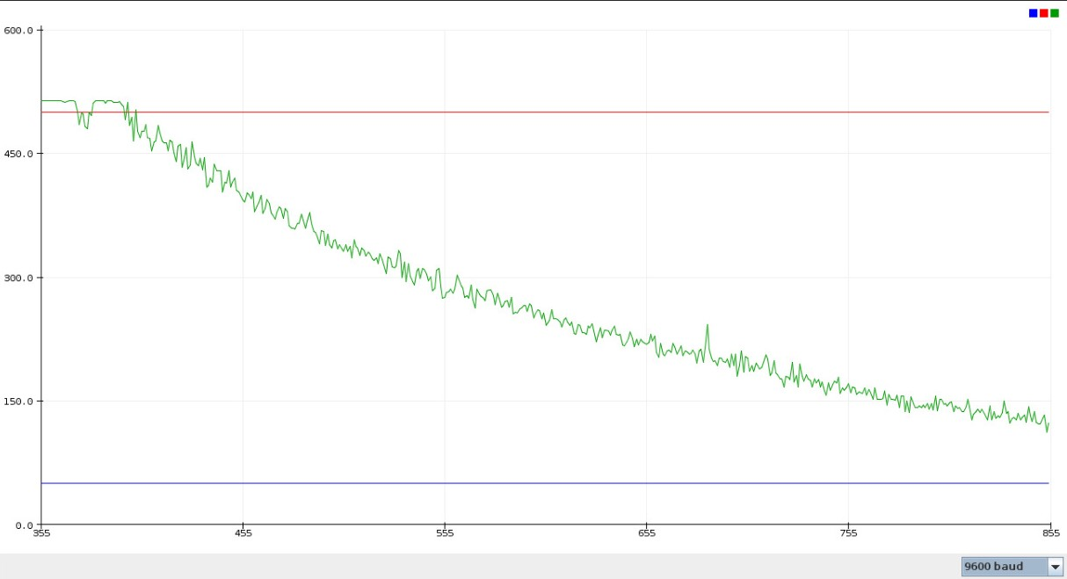
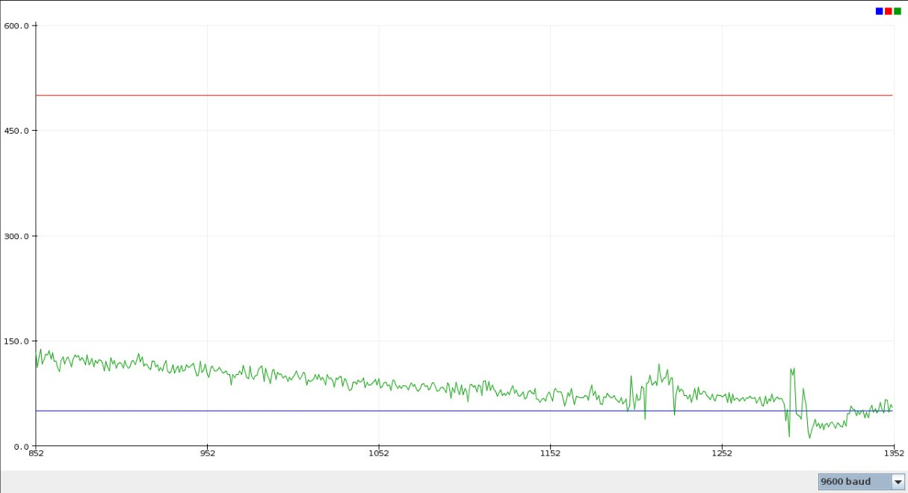
Indoor Air Pollution Controlling Device
Under the Guidance of:
Dr. Debdutta Pal
Abhishek Charan | Agnibesh Mukherjee | Arnab Pati | Avishek Shaw | Nadeem Akhter | Madhurima Maji
Computer Science Engineering
Calcutta Institute of Engineering and Management
Aim of the Project
Methodology
Implementation
Conclusion
Add your problem statement here in bulltes only.
Insert the proposed methodology or proposed solution.
We used a low power air pump to pump air into the mixture and got the following results:
Volume of air to be purified = 8294 L,
the flow rate of the air pump=210 L/hr
Time required to purify the volume of air=0.66 hr, in this time frame we saw PM 2.5 drop from 500 at the beginning of the experiment to 4 at the end of the experiment (the safe limit of PM 2.5 being 50). The graphs shown below have amount of particulate matter in the Y axis and time in the X axis.
We can conclude that air is being purified by the mixture of water and charcoal and it is happening in a definitive limit of time and is not an infinitely running process. The maintenance of our air purifier involves only changing the water from time to time and cleaning the activated charcoal by putting them under running hot water to clear the pores so that their property of adsorption is not reduced over time. Apart from that the only running cost is the cost of electricity which is required for running the air pump and the air quality monitoring device. We can look forward to developing this commercially so that a larger population can safeguard themselves from effects of indoor air pollution or air pollution in general.
Reference
Introduction
Algorithm and Design
Results
[1] Venkatesan, Priya. "WHO report: air pollution is a major threat to health." The Lancet Respiratory Medicine 4.5 (2016): 351.
[2] Sharma, Shyam Bihari, et al. "The effects of air pollution on the environment and human health." Indian Journal of Research in Pharmacy and Biotechnology 1.3 (2013): 391-396.
[3] Sharma, Anu Rani, et al. "Impact of agriculture crop residue burning on atmospheric aerosol loading--a study over Punjab State, India." Annales Geophysicae (09927689) 28.2 (2010).
In India air pollution worsens in the dry seasons due to number of factors such as burning of crop stubs in the months of September and October in north Indian states of Punjab Haryana and Uttar Pradesh results in heavy pollution in the following winter months in major cities such as Delhi, Noida, Gurugram etc., thus people are rather advised to stay indoors unless they need to travel outside so that they inhale less polluted indoor air. Indoor air pollution and poor urban air quality are listed as two of the world's worst toxic pollution problems in the 2008 Blacksmith Institute World's Worst Polluted Places report. It has been seen that pollutants in indoor air can reach toxic levels and the particulate matter in the indoor air is higher than permissible levels.
Add the algorithm and degin details.
From graph (I), (II)we can see the aforesaid result in which P.M 2.5 drops from 500 to below the permissible limit (indicated by the blue line)
Acknowledgements
Mention the acknowledgements for your project.

